Slide 1
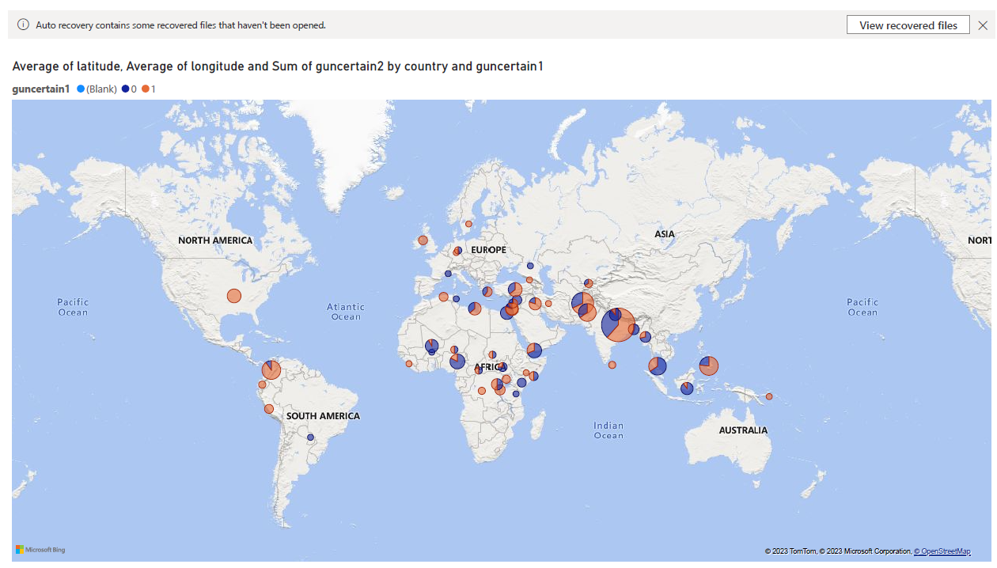

Slide 2
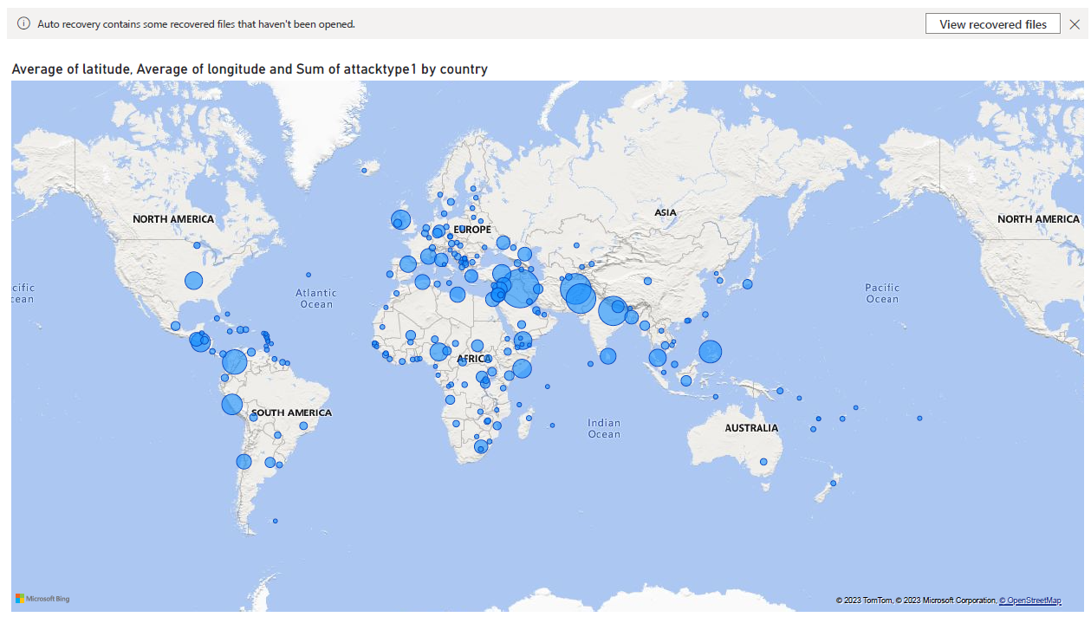

Slide 3
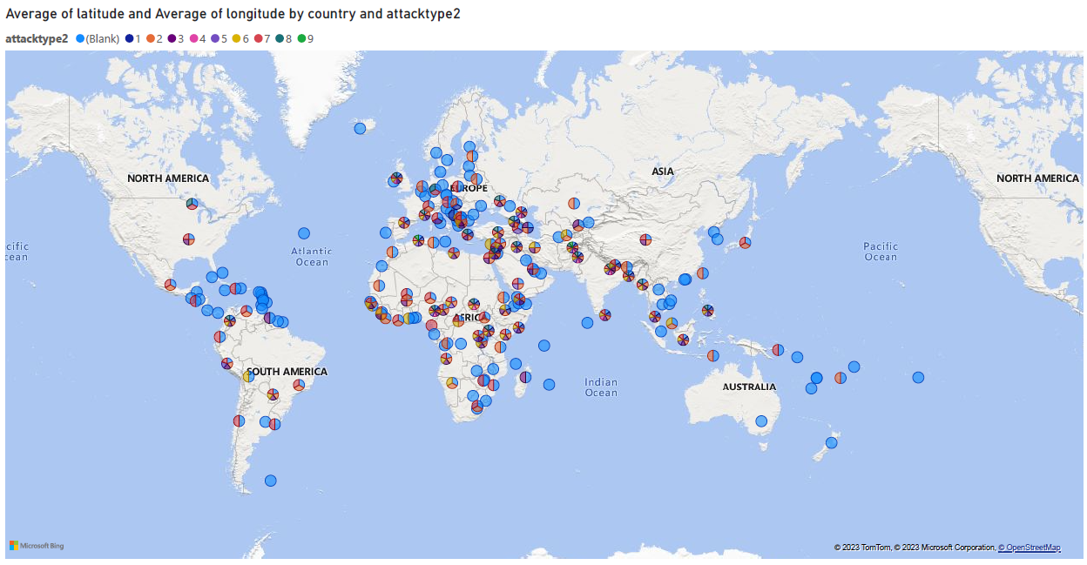
Create visualizations that display the number of terrorist attacks over time

Slide 4
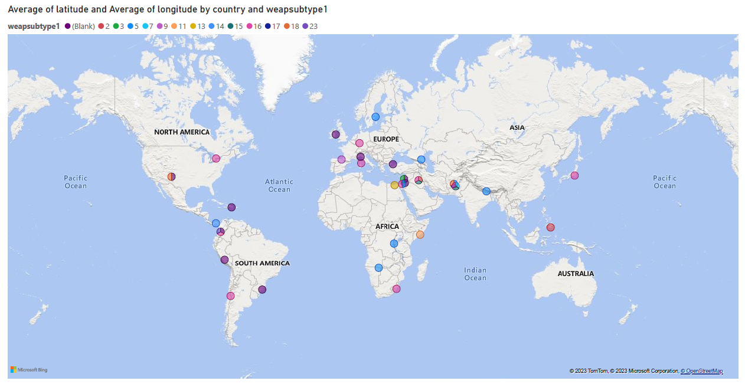
Analyze trends in attack types and weapons used

Slide 5
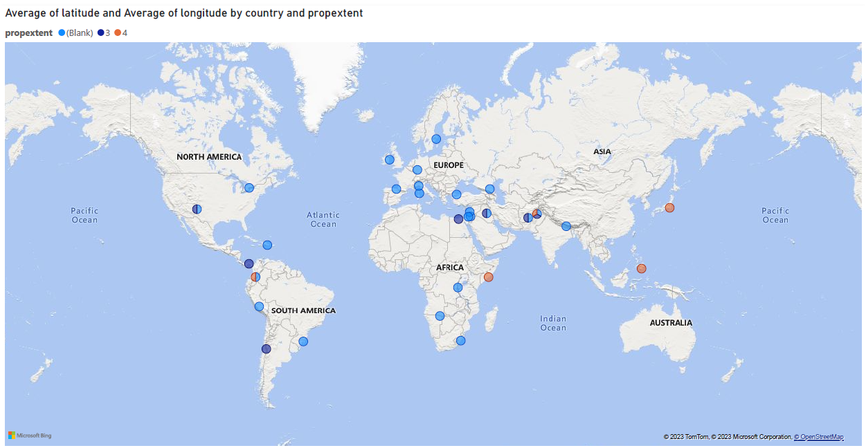
Compare casualties by region or year

